Slide 1
Meda Saikanth Reddy 001389103 Vennela Reddy Karaddi 001081643 Naga Vuyyuru 001344678
Refugee Management
System

Slide 2
Objective
Build an effective system to provision refugee with amenities and connect them with the hospital effectively through an NGO.

Slide 3
Problem Statement
Volunteers of an NGO serve as a bridge between refugees and hospitals.
Medical Camp Organizers request doctors of a hospital and provide refugees with a medical camp.
Fund providers help in the functioning of NGO by providing the required.

Slide 4
Approach
Refugee :
When a refugee needs medical attention, the refugee manager will raise a request to NGO.
NGO Volunteer :
When a request is received from refugee manager, a volunteer will be raising another request to the medical camp organizer.
Medical Camp Organizer:
When a request is received from an NGO volunteer, the medical camp organizer requests the doctor for the availability and upon approval, a medical camp will be arranged for the refugees.

Slide 5
Use Cases
Refugee Camp Manager:
Request Amenities from Amenities Provider.
Request Medical camp for refugees.
Amenities Provider:
Provide Amenities to refugee camp manager when requested.
Request inventory from Inventory manager.
Inventory Manager:
Provide inventory to Amenities provider when requested.

Slide 6
Use Cases
NGO Volunteer:
Request funds from Funds Provider.
Request Medical camp for refugees when a request is received from refugee camp manager.
Funds Provider:
Provide funds to NGO when requested.

Slide 7
Use Cases
Medical Camp Organizer:
Request doctor for availability when a request from NGO volunteer is received.
Doctor:
Request lab test from lab assistant.
Assign/Approve a request from medical camp organizer to conduct a medical camp for refugees.
Lab Assistant:
Provide lab test results to doctor when requested.

Slide 8
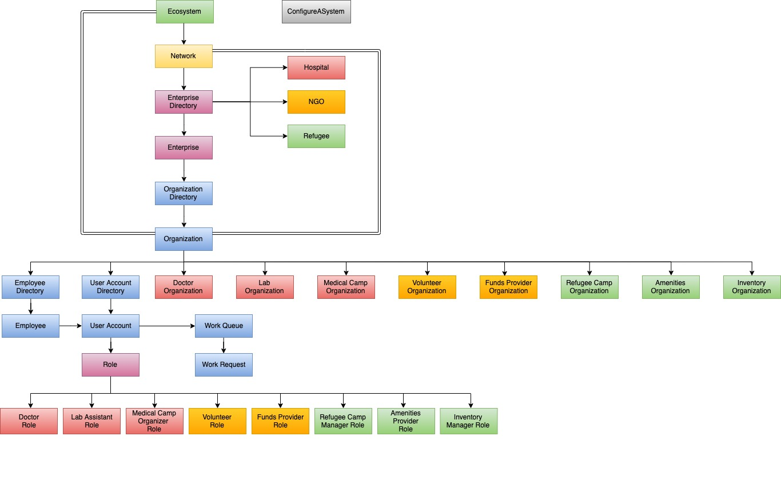
Object Model

Slide 9
Work Flow
Detailed work sequence for Medical camp Request
Refugee camp manager raises a medical camp request to NGO Enterprise’s Volunteer Organization.
Before processing the request, Volunteer needs to take acceptance from Medical camp organization (of Hospital Enterprise).
Medical camp organization must take acceptance from a doctor if he is available to provide support for medical camp.

Slide 10
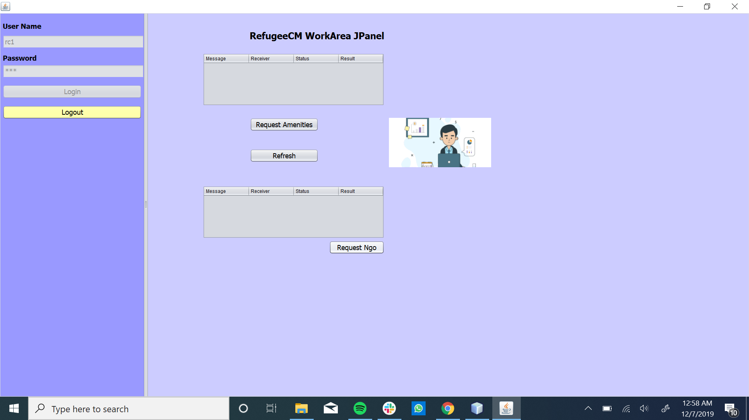

Slide 11
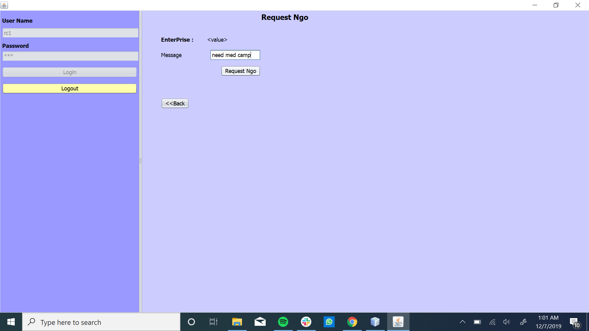

Slide 12


Slide 13
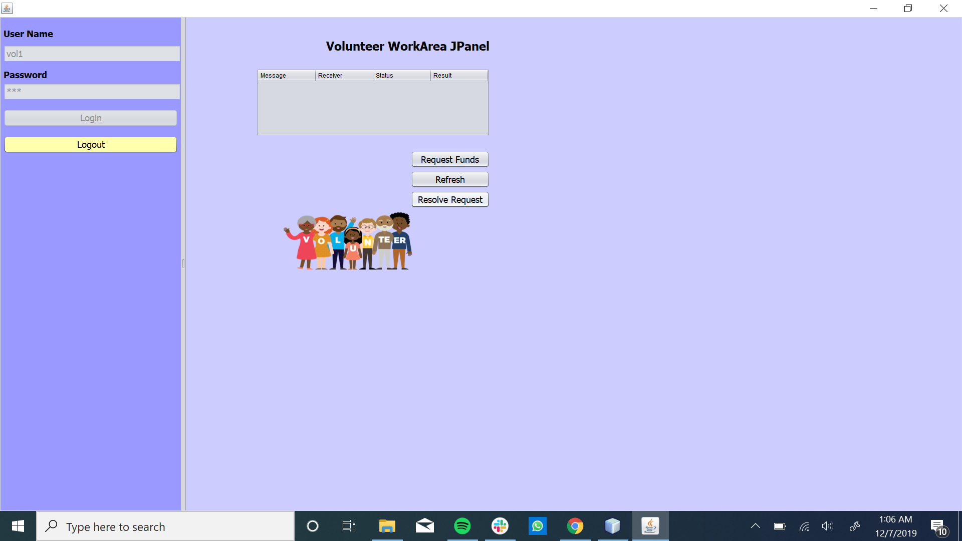

Slide 14
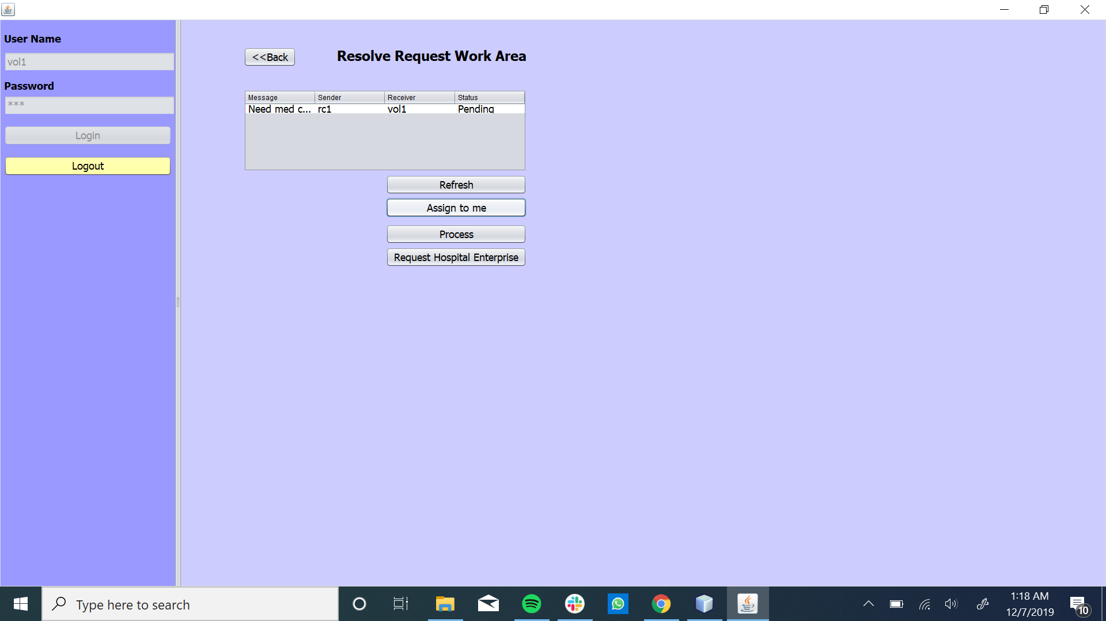

Slide 15
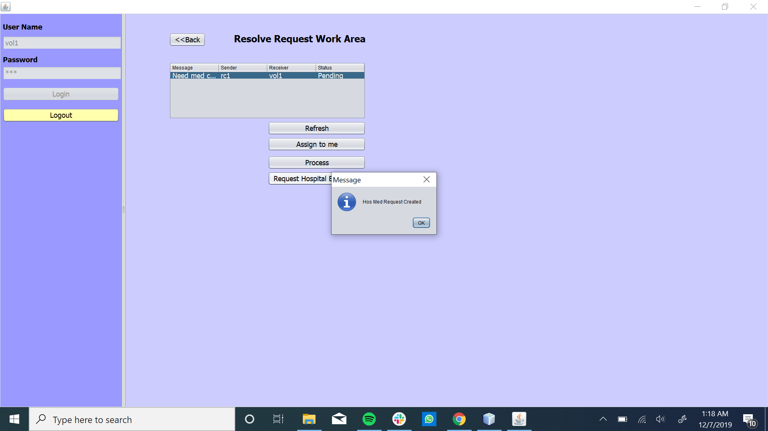

Slide 16
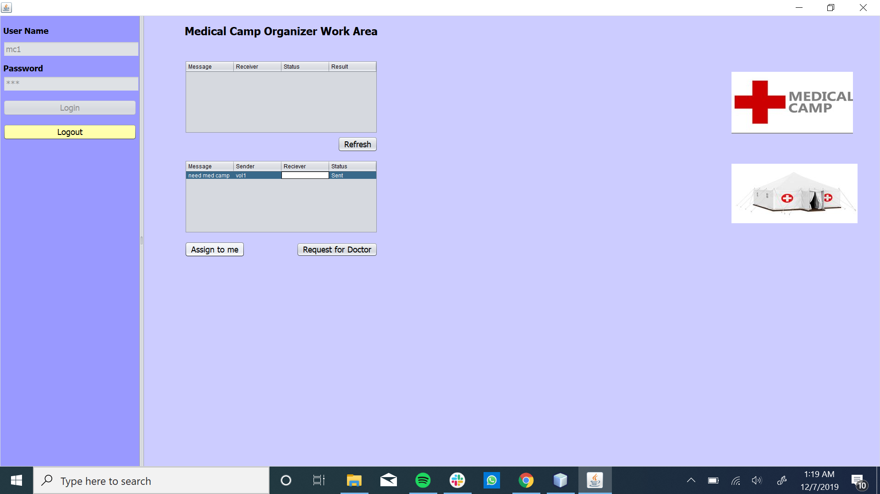

Slide 17


Slide 18
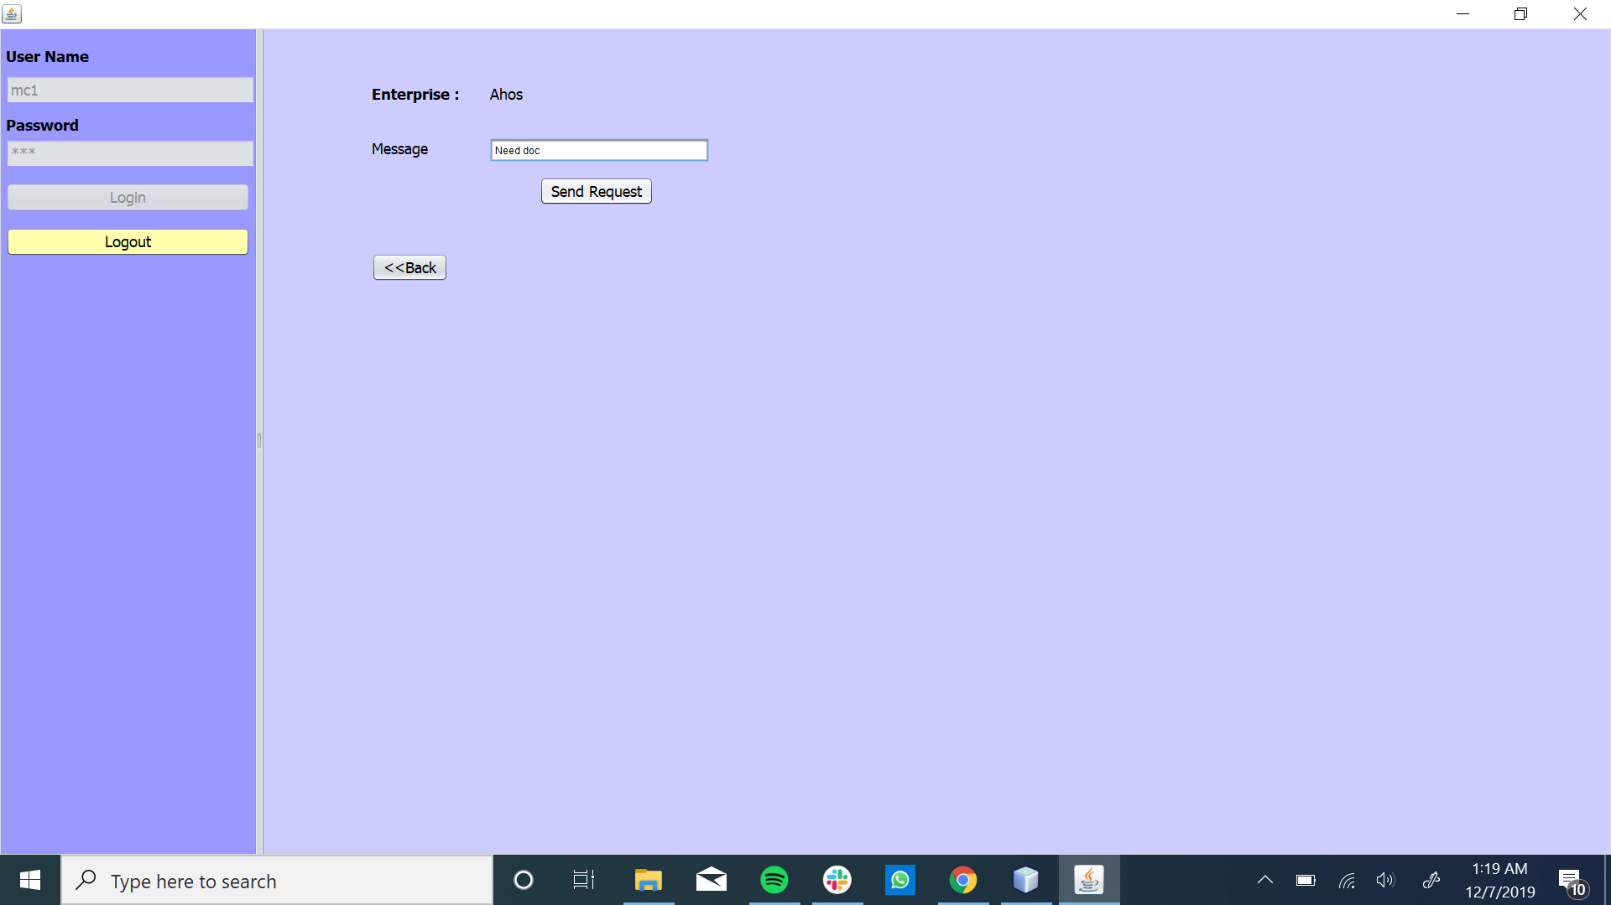

Slide 19
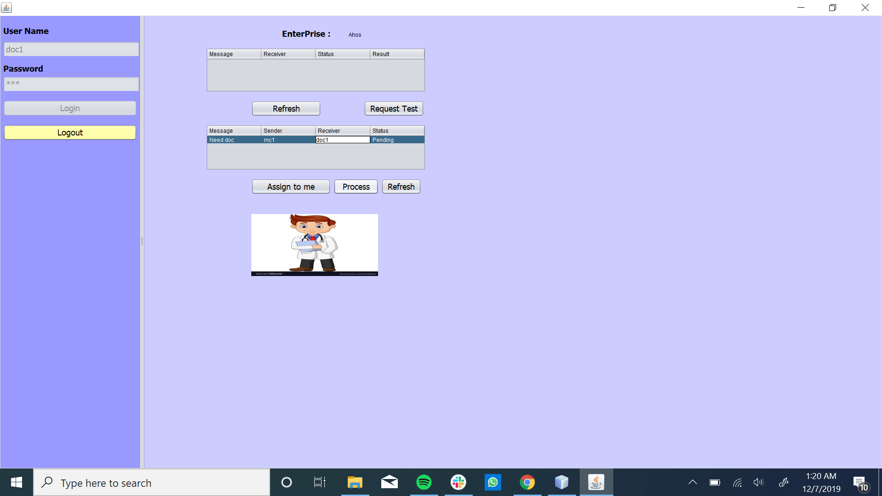

Slide 20
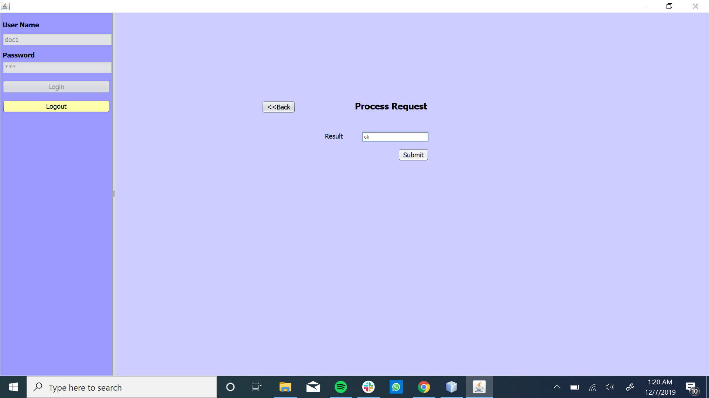

Slide 21
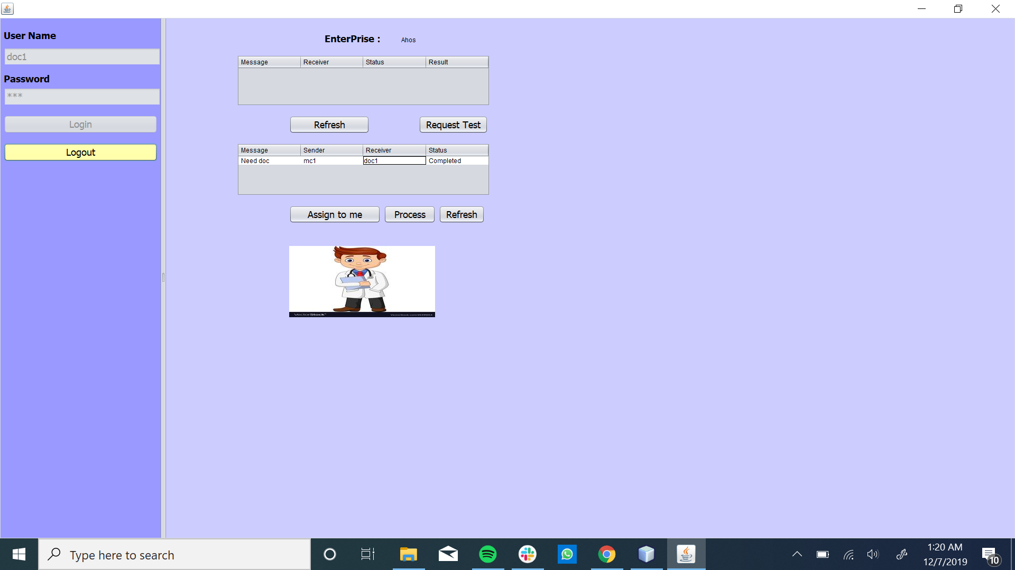

Slide 22
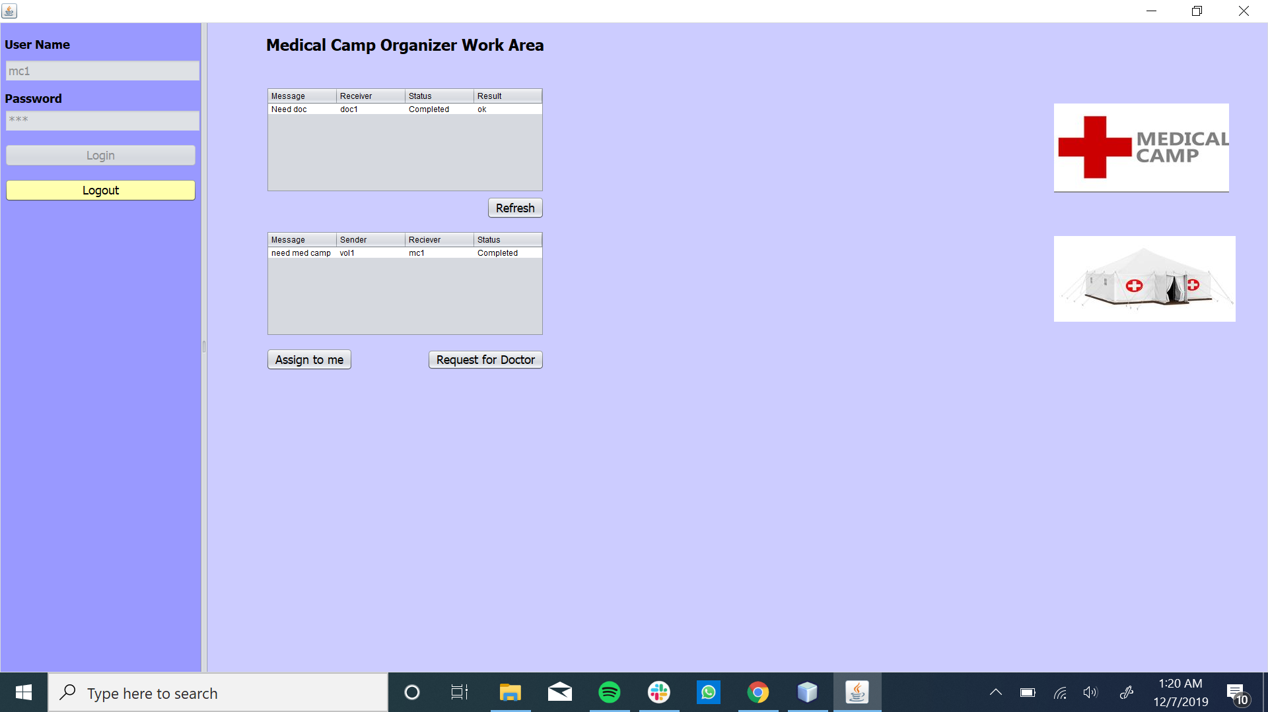

Slide 23
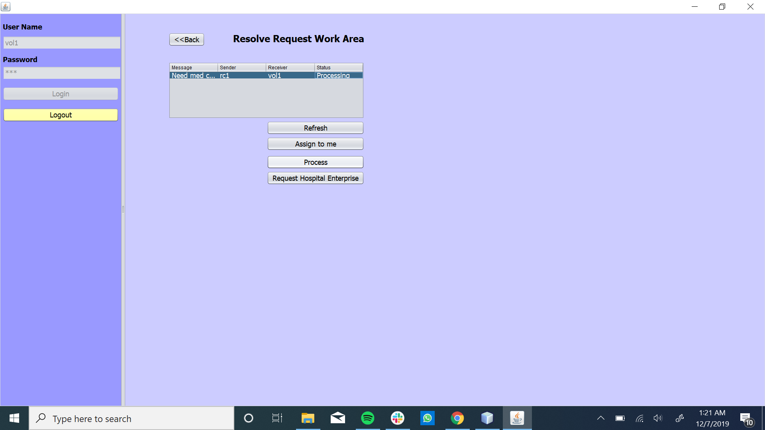

Slide 24


Slide 25
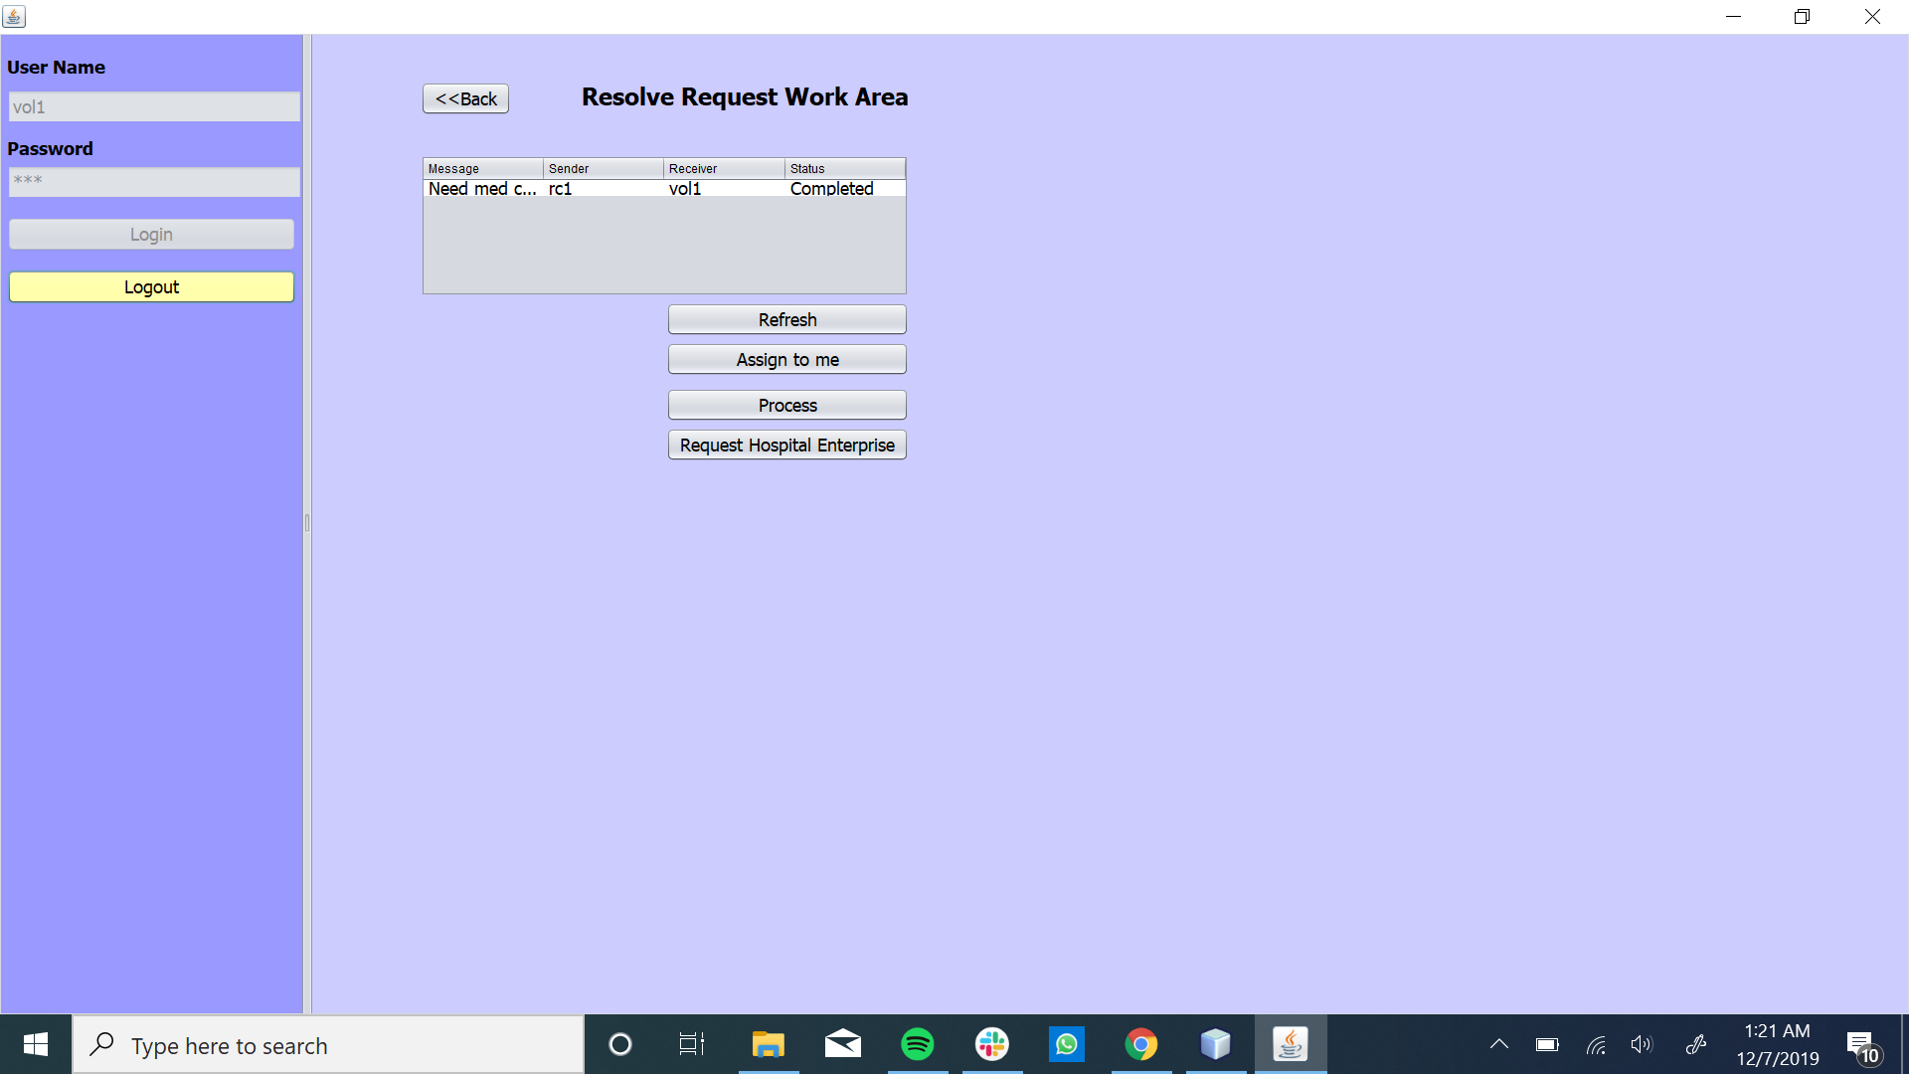

Slide 26
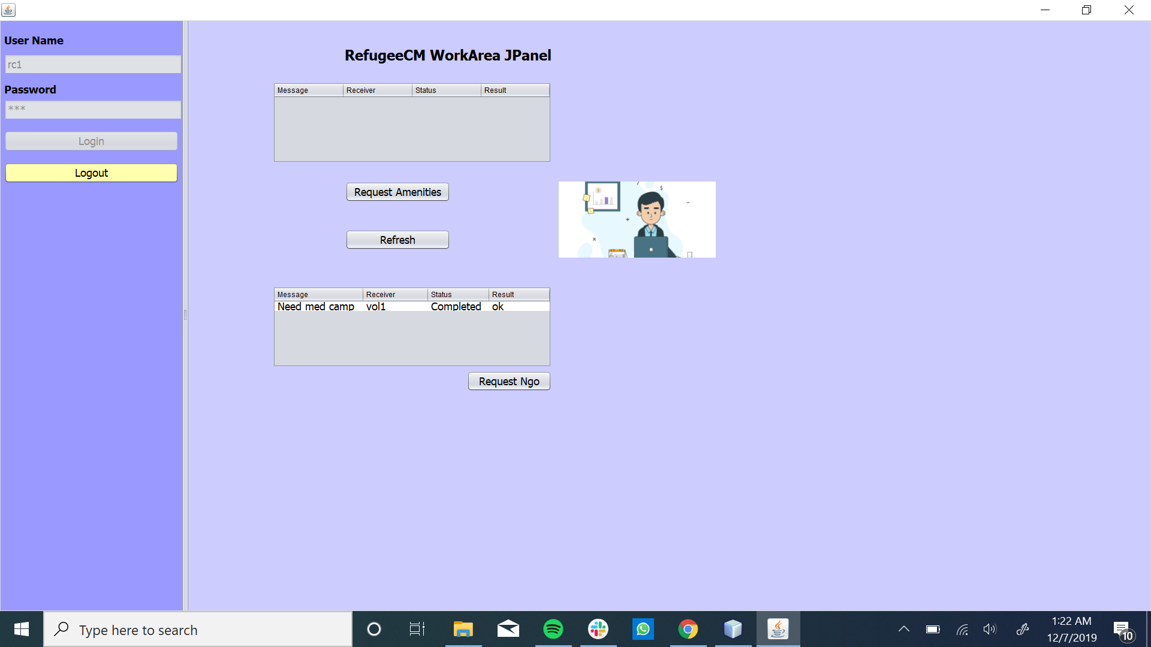

Slide 27
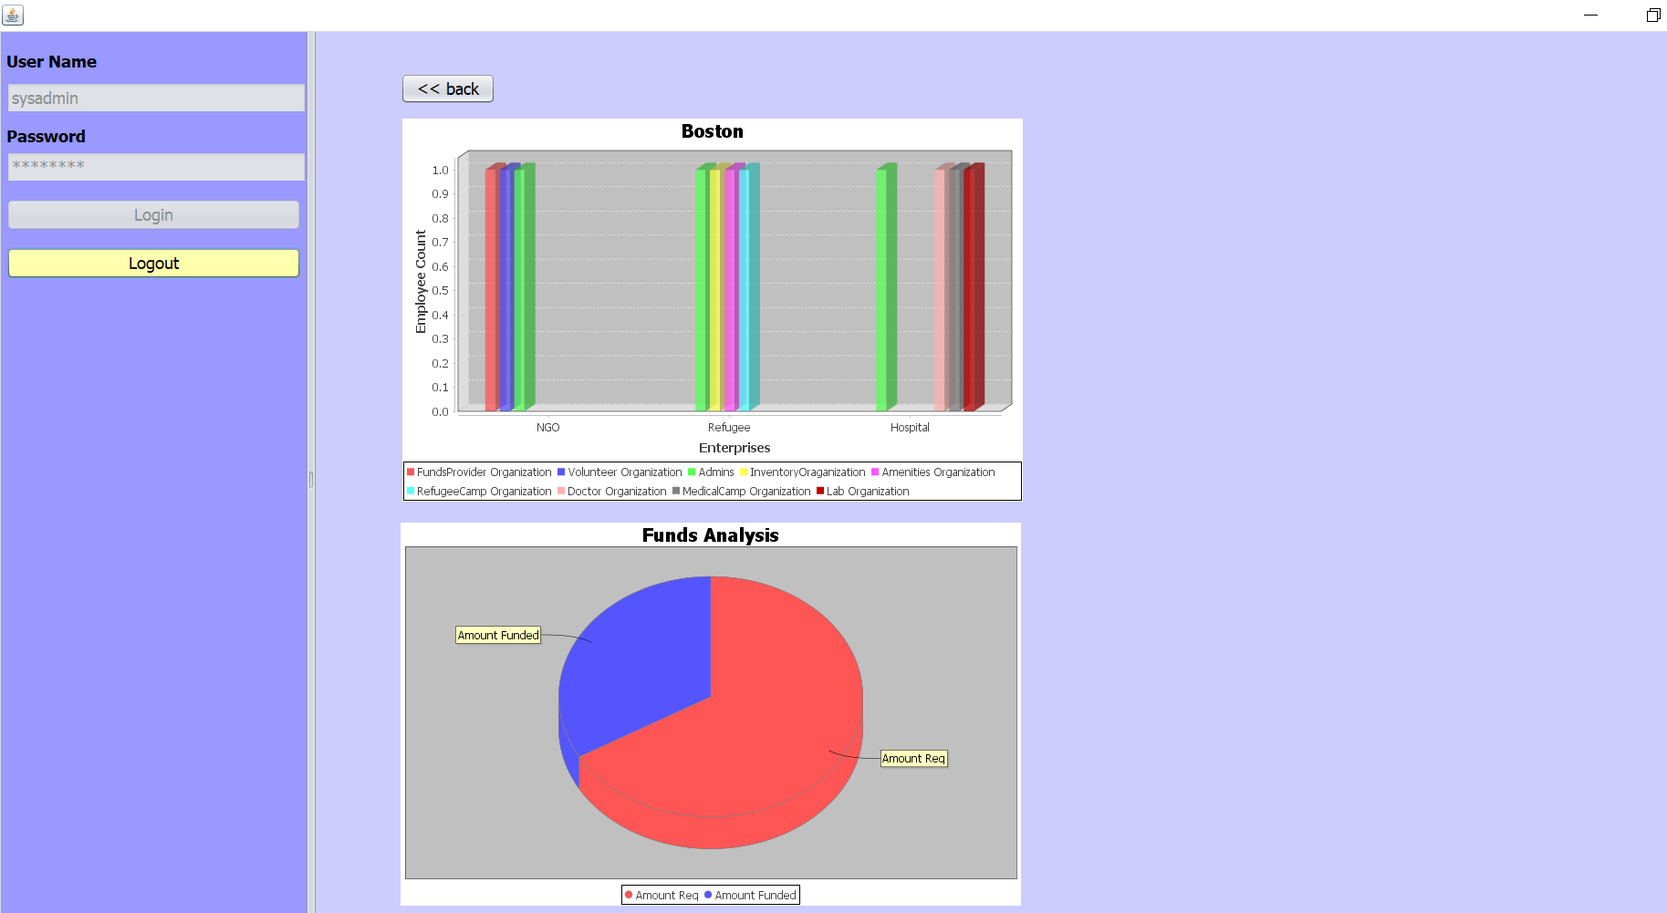

Slide 28
Volunteer Funds Request Work Flow

Slide 29
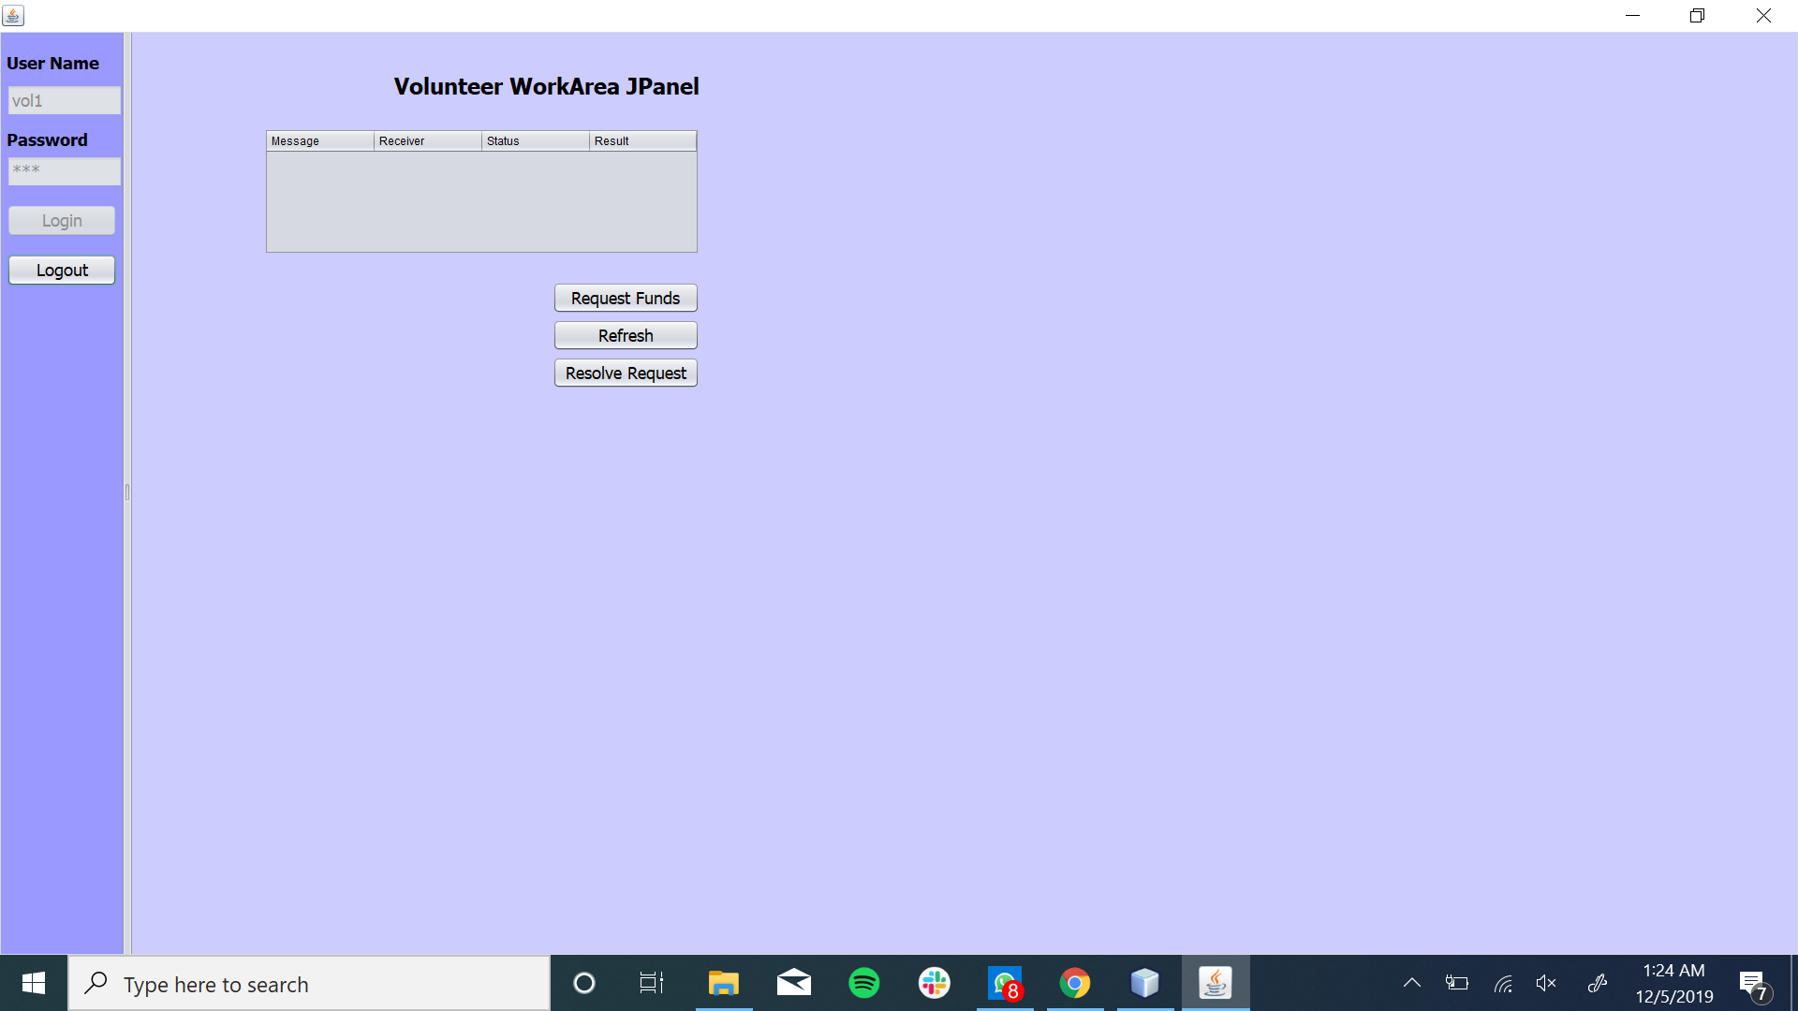
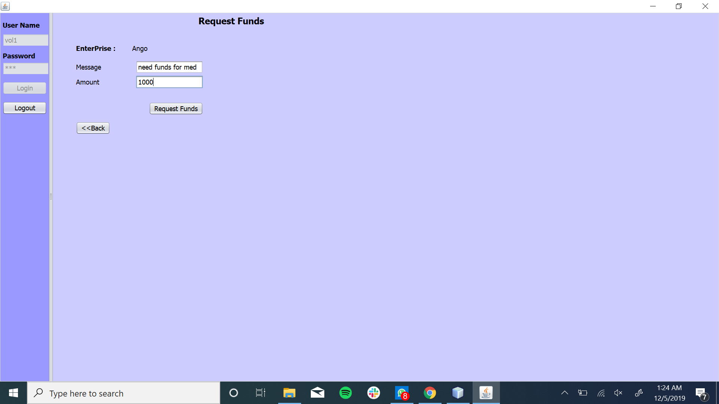

Slide 30
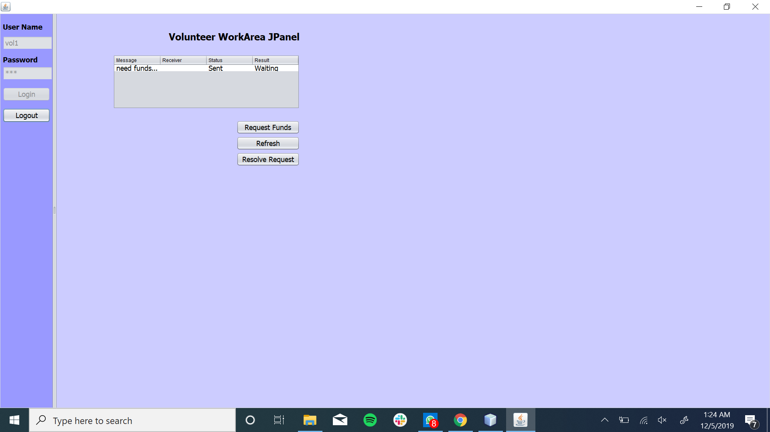
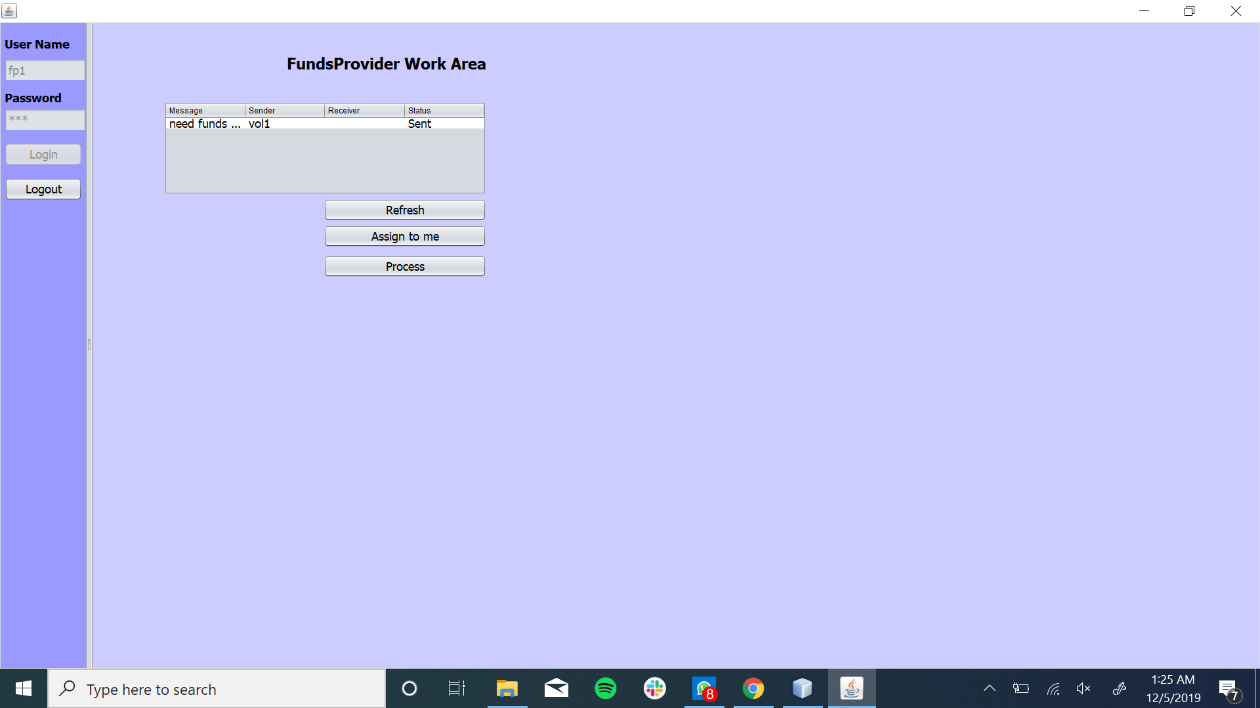

Slide 31
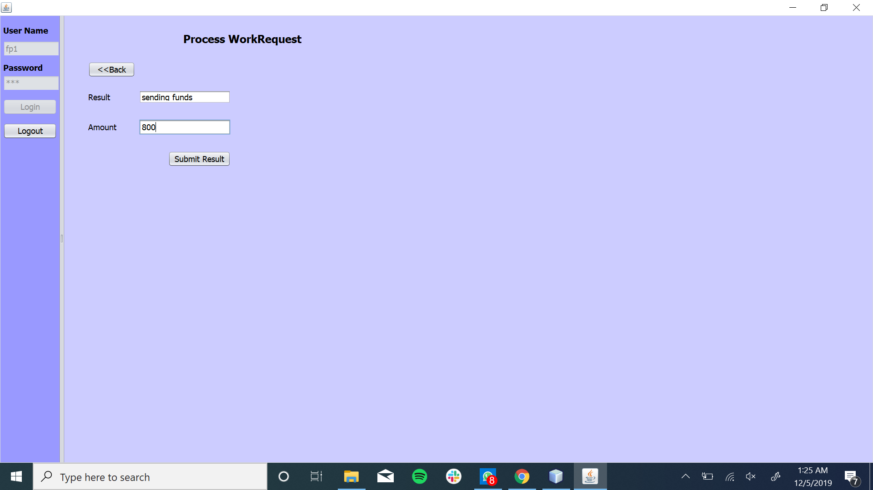


Slide 32


Slide 33
Amenities, Inventory Work Flow

Slide 34



Slide 35
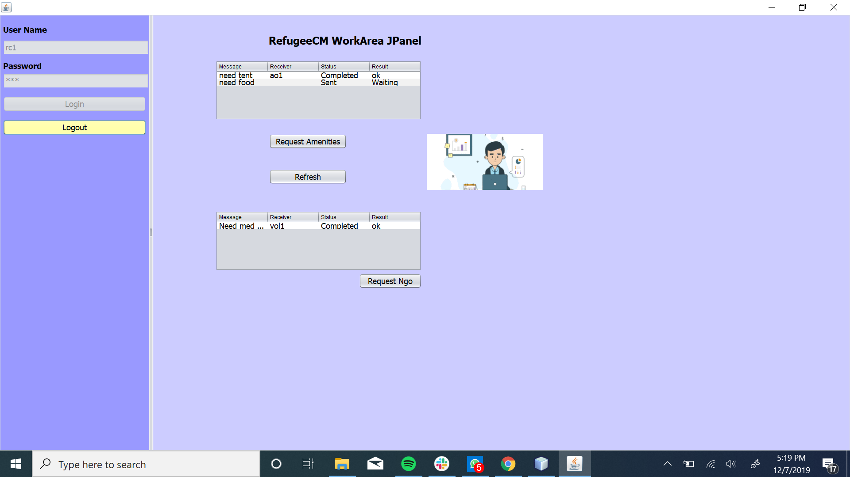
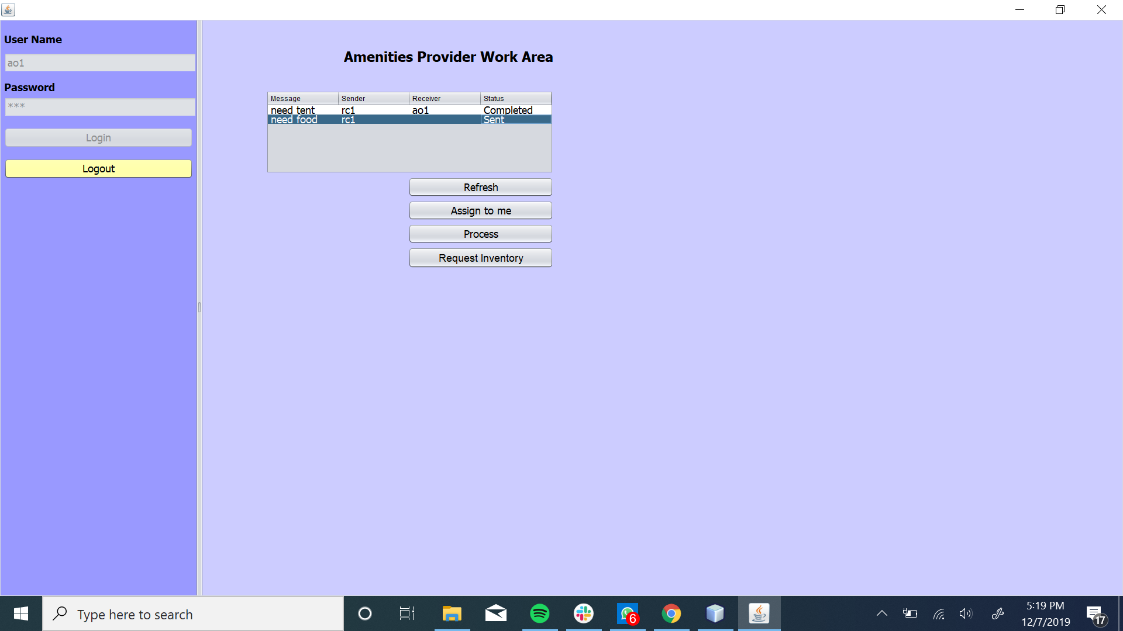

Slide 36
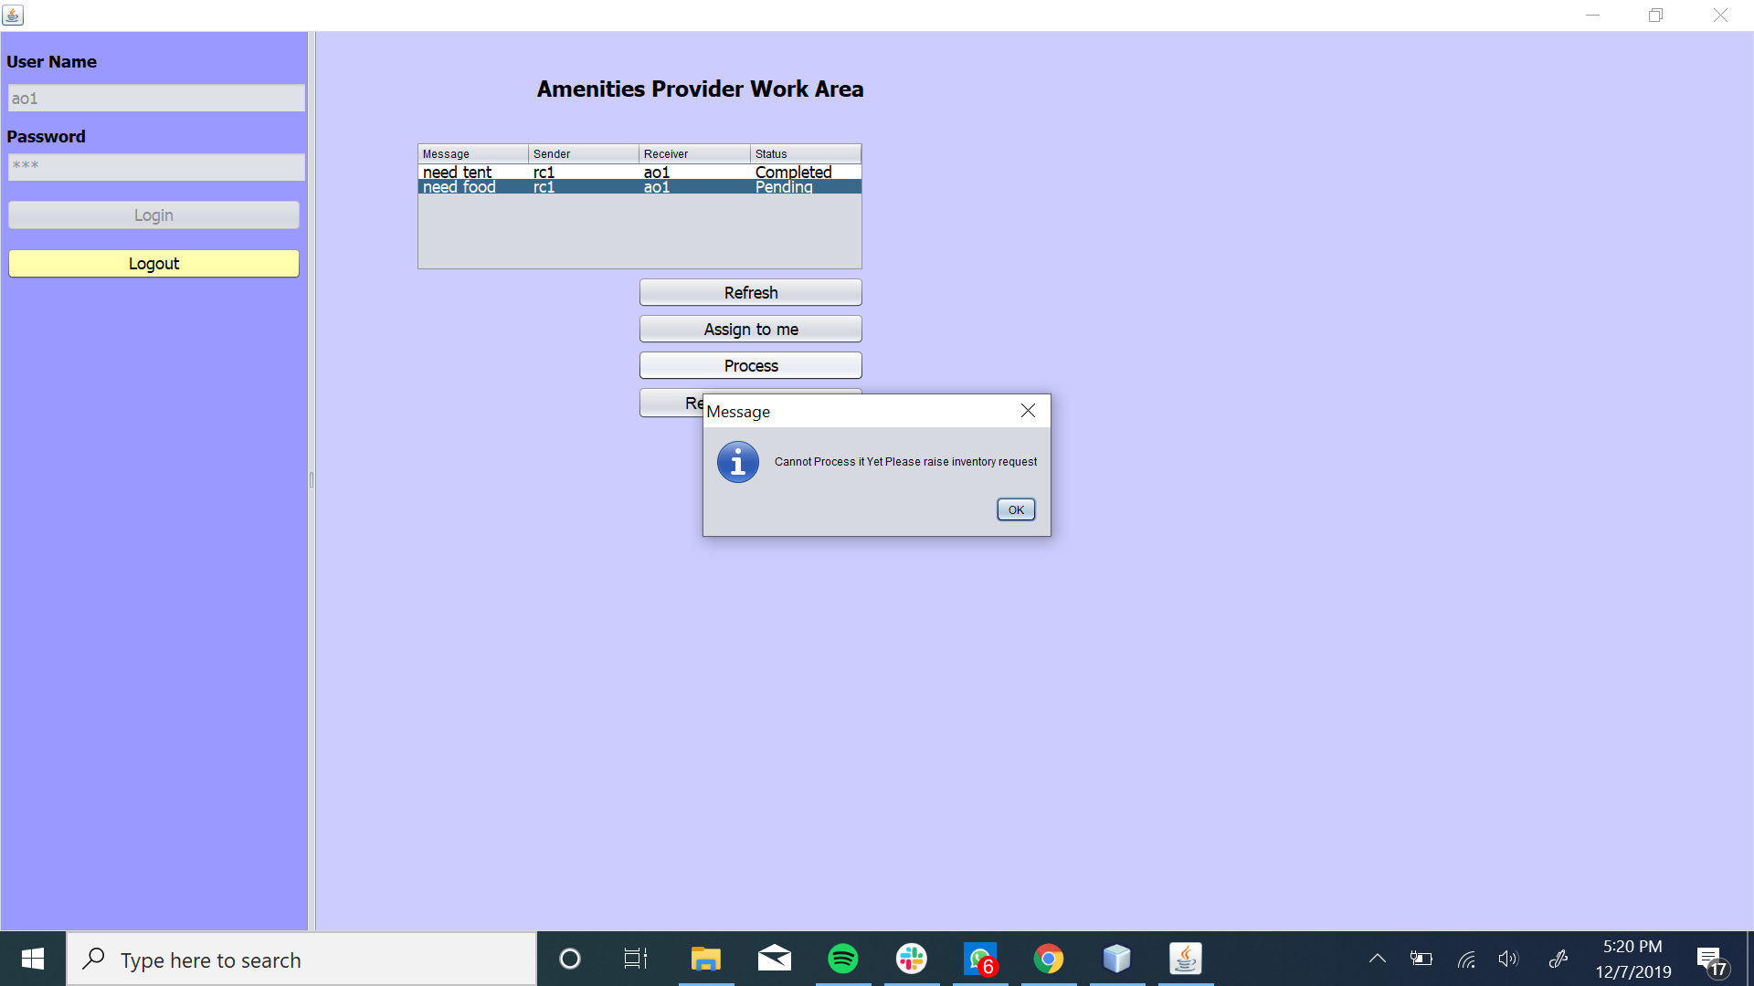
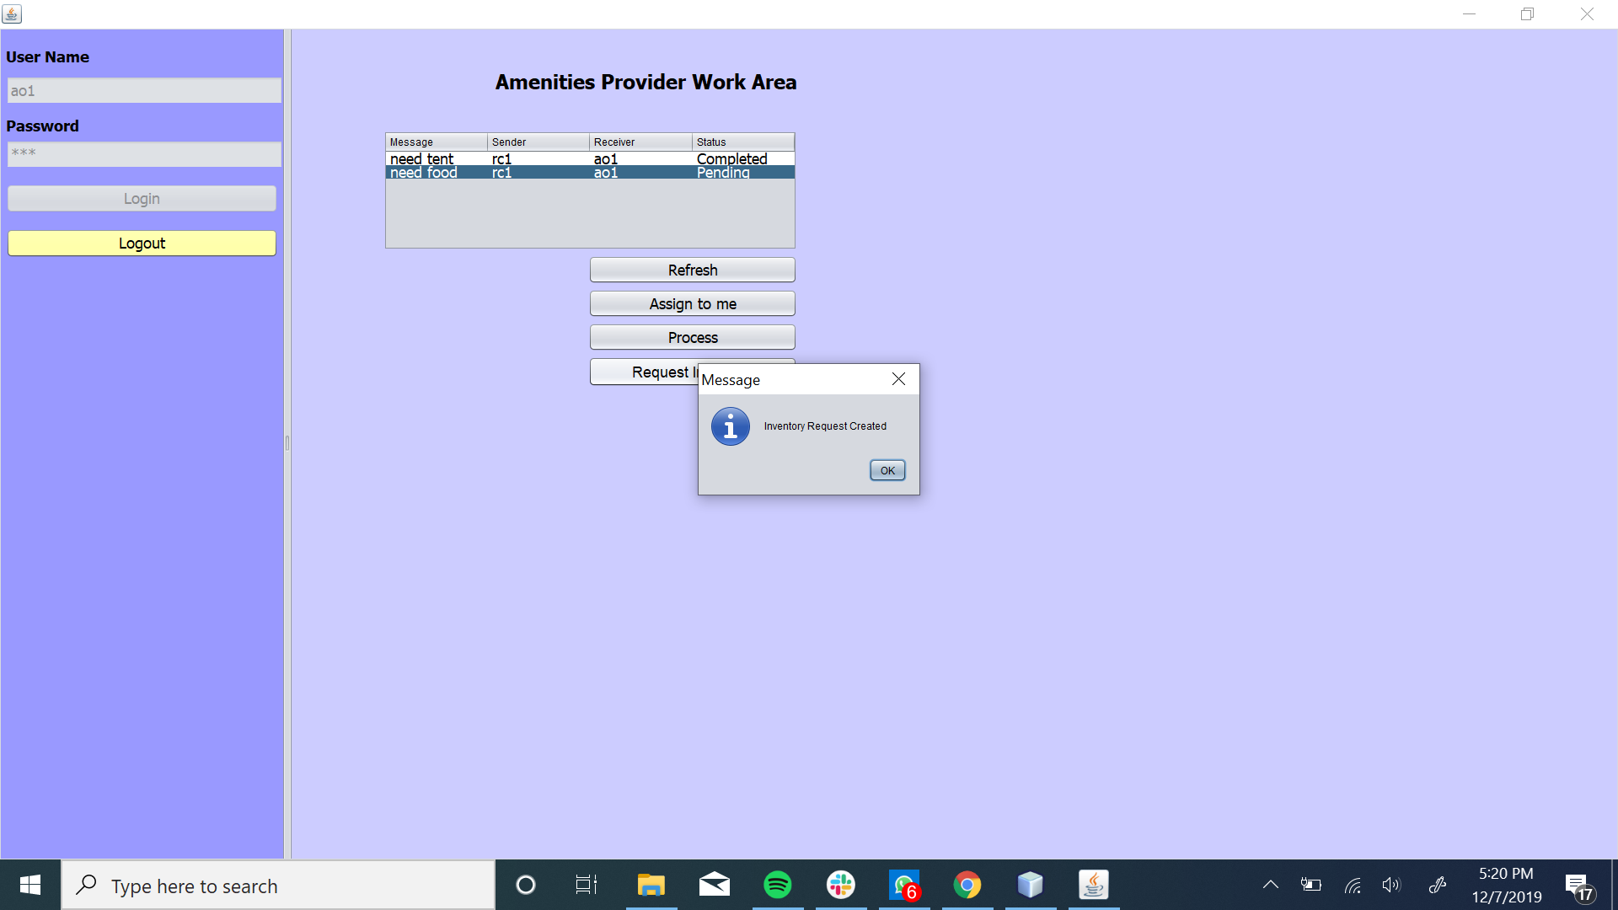

Slide 37
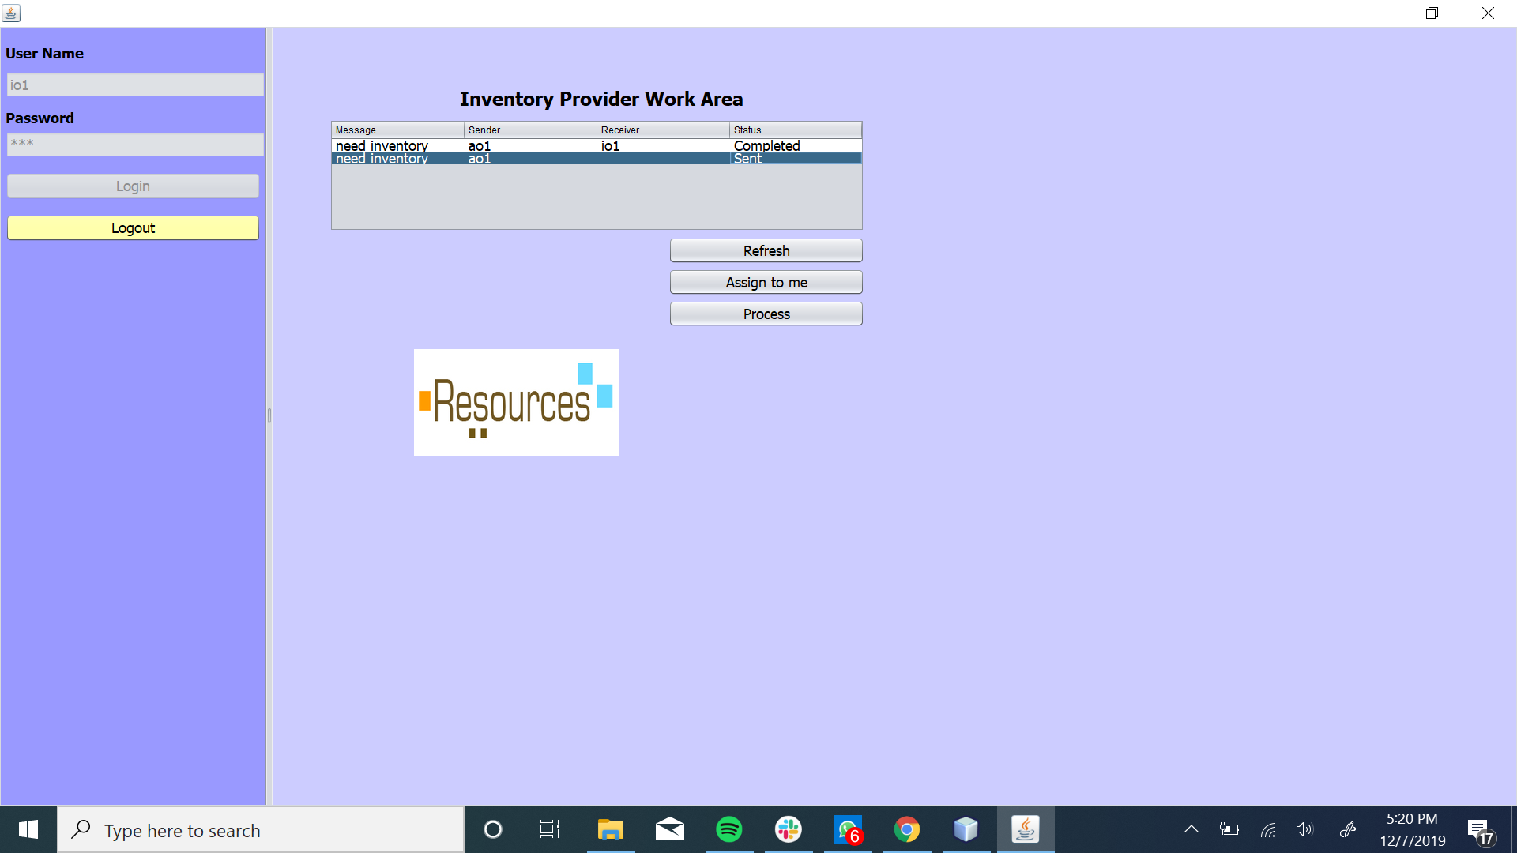


Slide 38
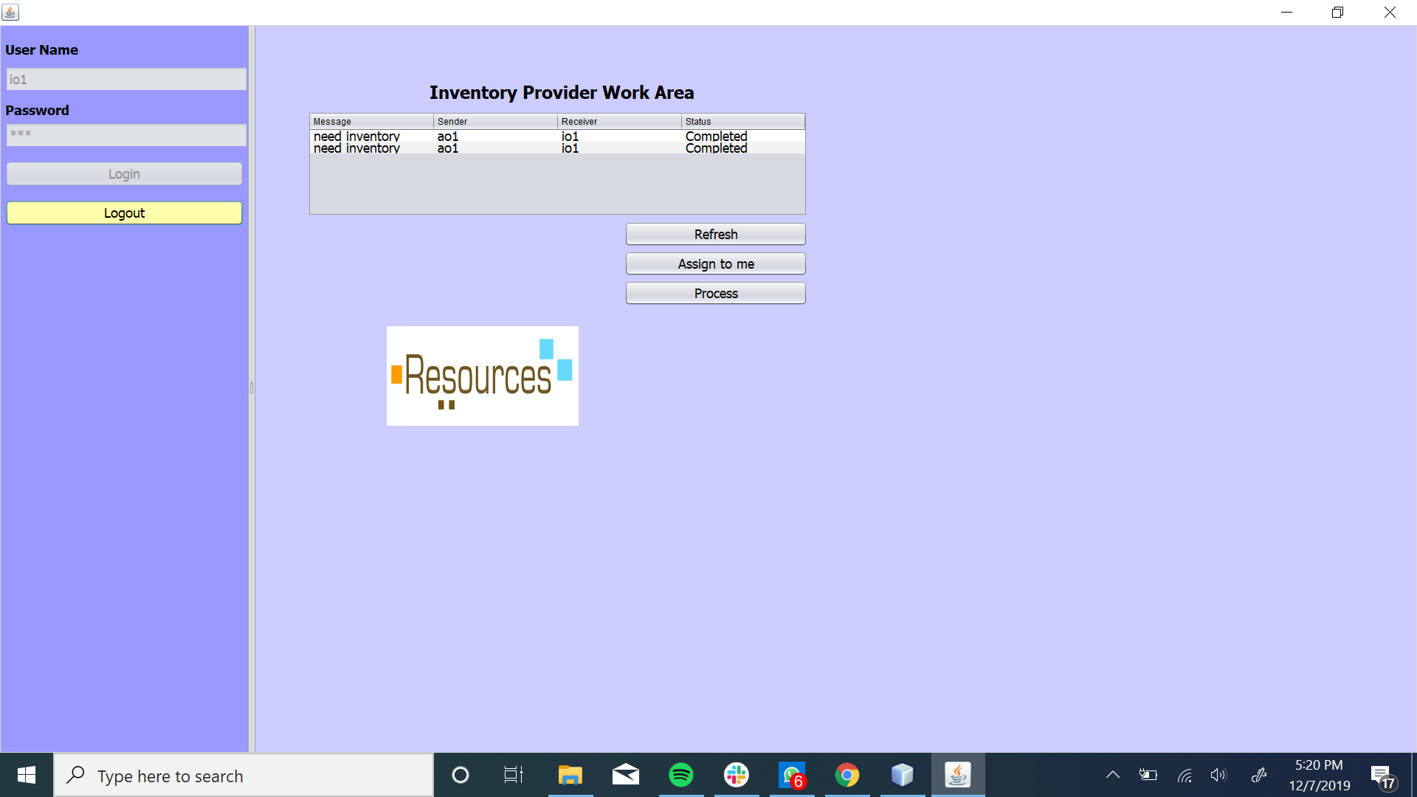


Slide 39



Slide 40


Slide 41
THANK YOU

